Slide 1
Employment Training Program
SD Associates
December 2017

Slide 2
OUR Goal
Build a foundation of vocational skills, that are transferrable in multiple career outlooks for young adults receiving behavioral services.
Simply, clients should learn what it means to be an employee and have a job. This program is designed to help clients understand the process of work, following a schedule, completing tasks, in addition to asking for breaks and help when necessary.
This program will help clients choose a career that they will enjoy, and guide them towards paid employment opportunities.

Slide 3
Why?
Individuals with disabilities are at an unfair advantage, with increased poverty rates, significantly less earned wages, and decreasing employment rates
Only 35% of U.S. civilians with disabilities between the ages 18 and 64 had a job in 2015, compared to 76% for people without disabilities
Historically, individuals with disabilities earn $10,000 less per year than those without, a continuing & increasing trend 2008-2016
The poverty percentage gap of those with and without disabilities, has been between historically above 7%

Slide 4
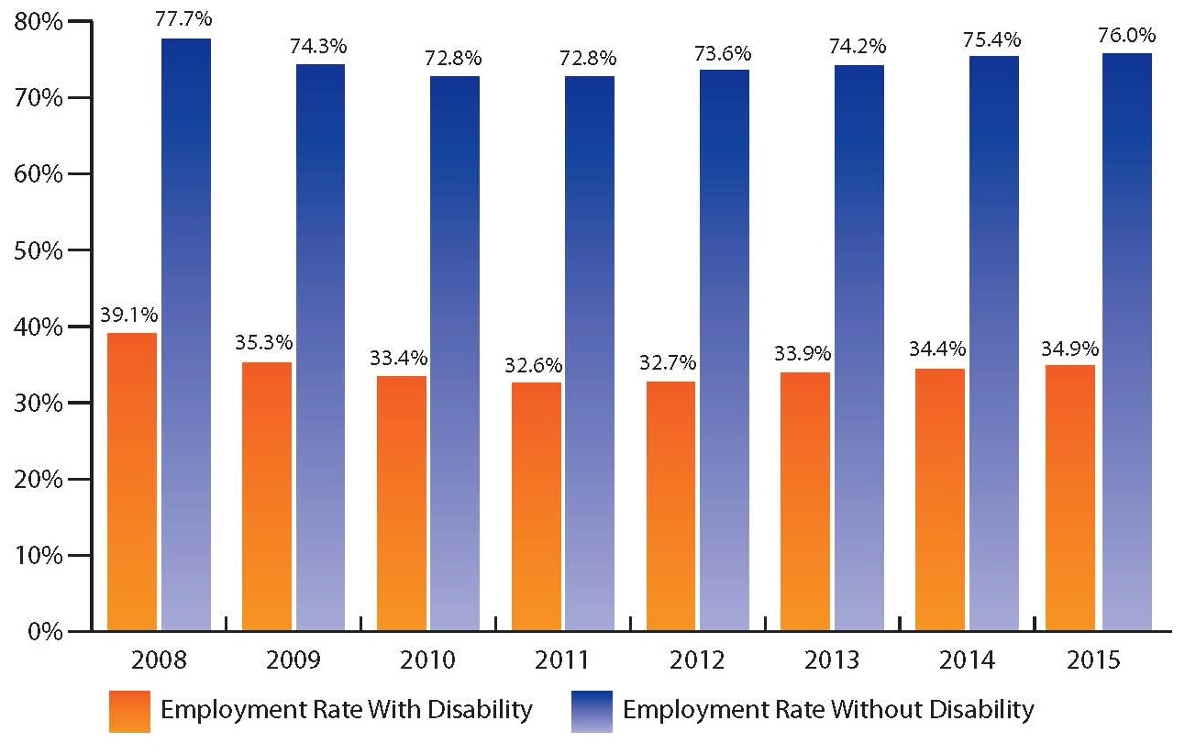
Employment Percentage, with and without Disability, 2008-2015
That’s less than half the employment rate!!
Data Source: 2008- 2015 American Community Survey, American FactFinder, Table B18120
Notes:
This slide shows, in the US in 2015, 34.9% of people with disabilities ages 18-64 living in the community were employed. The employment percentage was more than double for people without disabilities, 76.0%. Figure 16 also shows this continuing pattern of difference in employment between people with and without disabilities since 2008, spanning an economic downturn and recovery.

Slide 5
Learning procedure
Instructors will help their client achieve success following a task list. In addition, social stories have been prepared, located in the work area. We have a work table in the community space & product is located in the closet near reception.
Instructors will collect data for the Employment Training Program Task List analysis, in addition to existing client-specific data sheets.
After completion of the minimal 20 sessions, the team can assess progress and provide direct assistance to the clients employment needs.

Slide 6
Program logistics
Skill building will focus on following directions, reading a task list, following a schedule, time management, communication, workplace navigation.
Secondary, students will have exposure to a new skill, and utilize the programs for Bx Rate increases, prompt fading, as well as an increased stamina/duration for tasks.

Slide 7
How?
Behavior Analyst’s firstly conduct a “form of interest” to specify if a student is interested in an internship program, or a learning activity.
Internship programs require students to meet a minimal number of (20) 15 minute sessions before further assessment.
Learning activities are available for students who are interested in participating but can not make the time commitment. The Employment team will work with the client-specific team to make adequate employment recommendations.

Slide 8
Partnering organizations
Currently we are partnered with Andy’s Dandys for the Internship Training Program. After completion of the minimal sessions the team will work with the Employment Liaison to arrange a desired paid employment.
Desirable paid employment can be through Andy’s Dandys if the client chooses, however the team can explore other business opportunities that appeal to client interest.
In the future we will look at other businesses and/or organizations to work with us on this program for paid employment opportunities.

Slide 9
Specific jobs
With Andy’s Dandys we have teaching materials prepared for the following specific job opportunities:
Folding Boxes
Bagging Treats
Sealing Bags
Shrink Wrapping
Weighing & Sealing Bags

Slide 10
inquiry
To get your client enrolled please e-mail jimmy.martin@sdplus.org to file an official “Form of Interest” and we will do our best to schedule immediate sessions.

Slide 11
